Slide 1
How to spend a day-off in Moscow
The Battle of the Neighborhoods (Week 2)
This presentation is done within the Courser course 'Applied Data Science Capstone'

Slide 2
Table of Content
Introduction. The Problem Description
Data
Methodology
Results
Discussion
Conclusion

Slide 3

In this project we are going to help families with kids to plan their day-off.
In big cities, such as Moscow, there are thousands of venues that could be interesting for families with kids. But unfortunately, parents do not know about them. In fact, there is a very limited list of popular venues mostly placed in the downtown, that are known well to everybody. They are nice but always overcrowded and it could take more than an hour to get there through traffic jams. And parents encounter more problems when they are going to plan several activities for the same day. For example, where they could eat with kids, or what they will do if their plans, weather or mud suddenly change.
We use the data science and data visualization tools to display on the map the clustered venues affordable for families with kids. That clusters will include venues for education and entertainment and will be placed in the specified neighborhood.
Introduction
The Problem Description

Slide 4
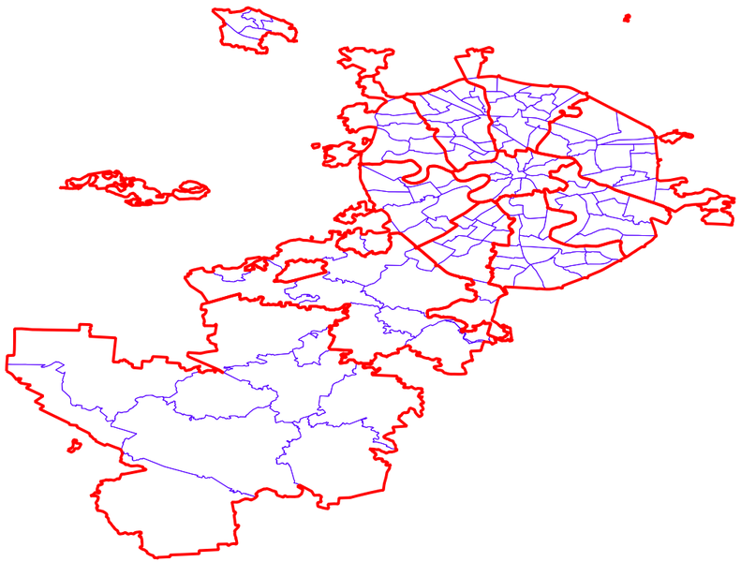
Data
How to determine neighborhoods
There are 12 administrative districts in Moscow that include 146 municipalities. The list of them that includes their boundaries can be downloaded at http://gis-lab.info/qa/moscow-atd.html in ESRI Shape, GeoJSON, CSV+VRT or KML formats.
To download the data for Moscow municipalities we use the link
http://gis-lab.info/data/mos-adm/mo-csv.zip

Slide 5
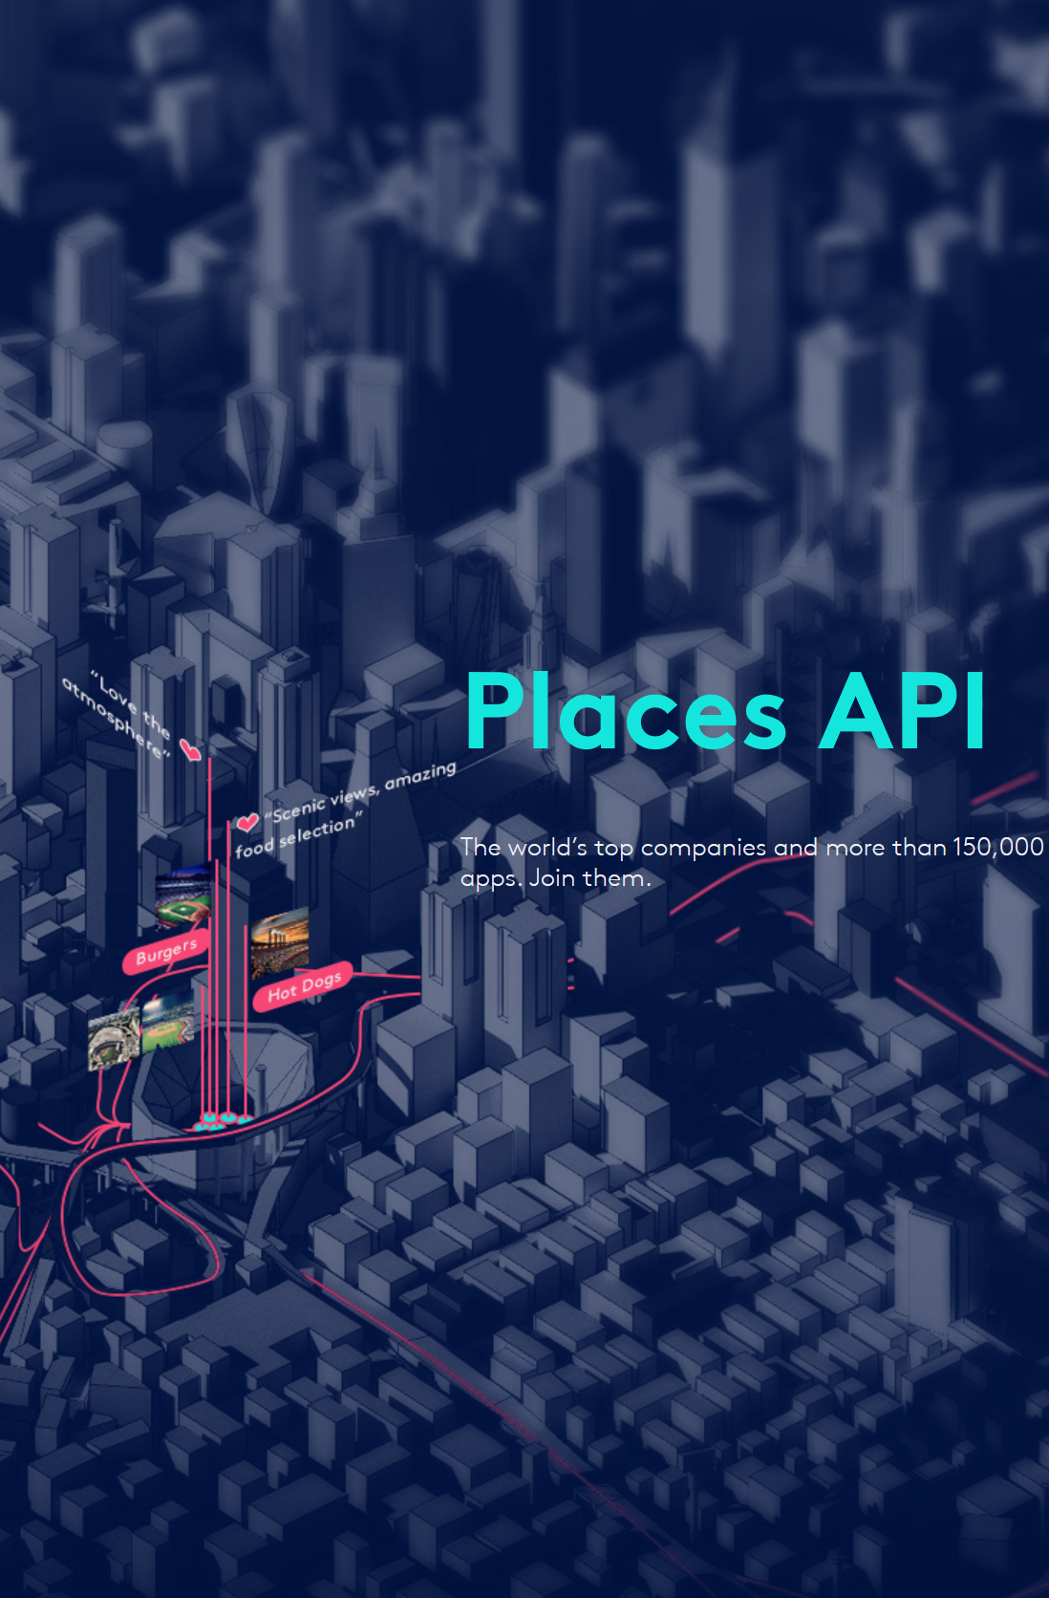
Data
How to mine information of venues
We can do it with the Foursquare API and the method called 'explore'.
With that method we can download the data of venues we are interested in placed no farther that some specified distance form some specified geo coordinates
Example or url request:
'https://api.foursquare.com/v2/venues/explore?&client_id=VC5VAI2CNSBEQ1BIWEREK0RDJX2VK4WVRYEXQTSLB4Q4XXFB&client_secret=HRGWOCZXY555UGMEUD4APX5LYXYTREVQNOLEQZJT1YFRW3U3&v=20180605&ll=55.7504461,37.6174943&radius=1000&limit=20'

Slide 6
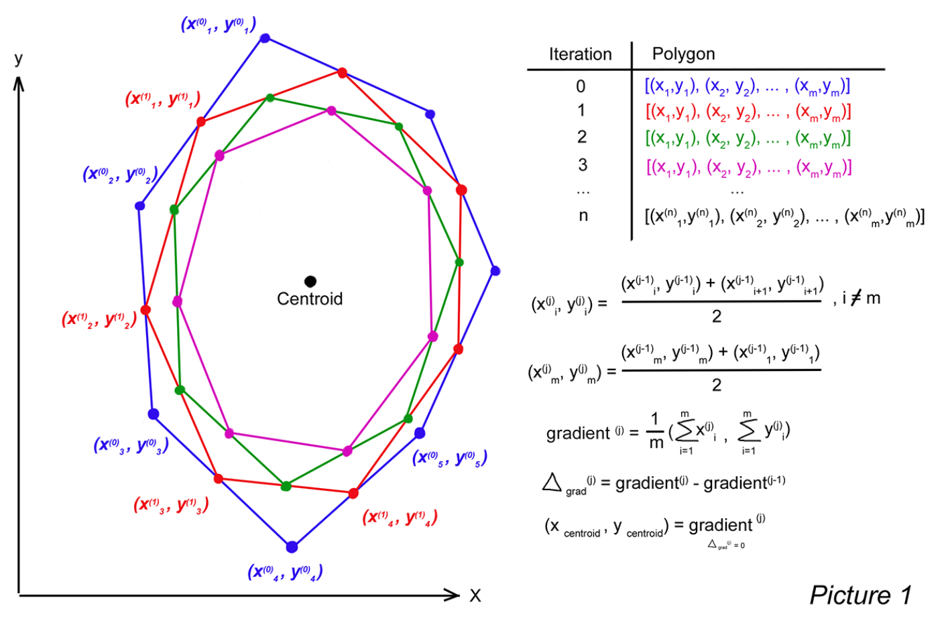
Methodology
To find the center of each neighborhood that is described as the municipality's boundaries we have to develop an algorithm
Polygon is a set of lines connecting points one by one. We will find the middle of each such line and redraw the polygon by connecting them. That's an iteration procedure. At every iteration polygon will be convoluting around some point that is centroid we are looking for. The indicator of the process called 'gradient' is an averages of longitude and latitude for all points. If after some iteration gradient stayed the same, we can tell that centroid was found. The Picture 1 below illustrates the algorithm.

Slide 7
Methodology
Venue type | Catergory Id
Parks | 4bf58dd8d48988d163941735
Entertaiment centers | 4bf58dd8d48988d1e1931735
Amusement parks | 4bf58dd8d48988d182941735
Playgrounds | 4bf58dd8d48988d1e7941735
Museums | 4bf58dd8d48988d181941735
Cinema | 4bf58dd8d48988d17f941735
Kids cafe | 4bf58dd8d48988d1d0941735
To clarify what venue categories we are interested in we can look through the content by the link https://developer.foursquare.com/docs/resources/categories that includes categories id.

Slide 8
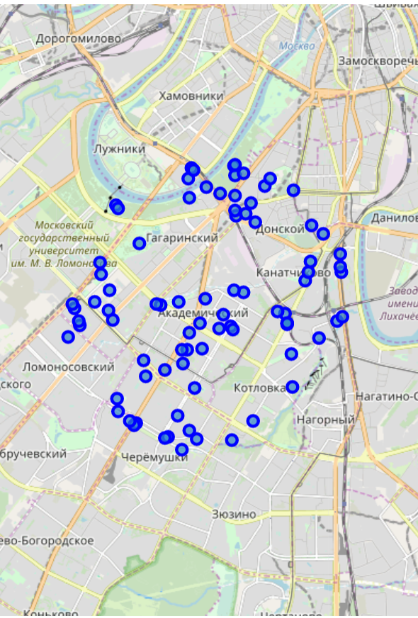
Methodology
The venues data presentation on the map can be optimized by clustering.
To split the venues into clusters we'll use K-Means method to group together the venue situated close to each other.
This approach will help customer to pick up the most appropriate cluster concerning distance and a set of the venues in it.

Slide 9
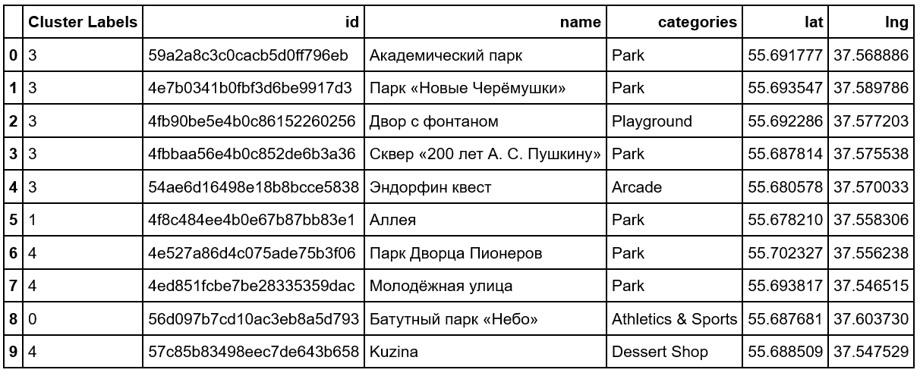
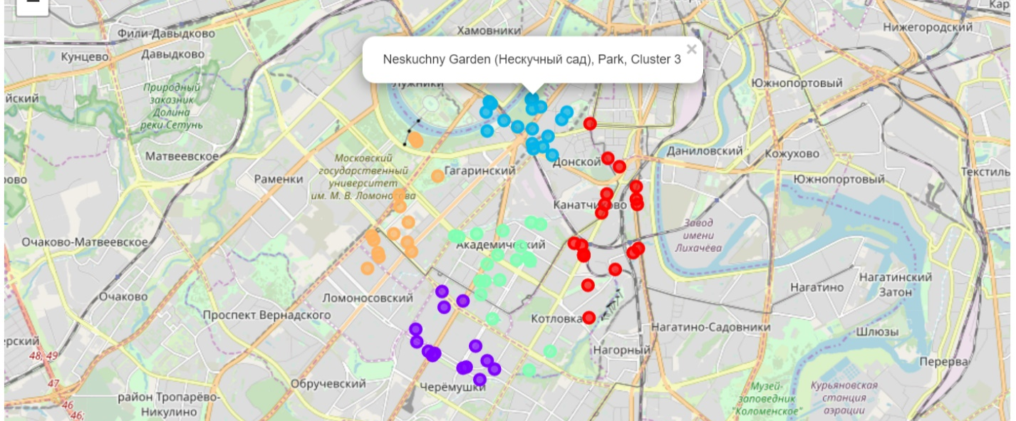
Results
We have the venues affordable for families with kids on the map splitted into 5 clusters. The list of venues categories shows that all the venues are affordable.
The 'Shopping Mall' got in the list since there are cinema multiplexes there together with kids' cafe and some attractions.
Index(['Arcade', 'Art Museum', 'Athletics & Sports', 'Cupcake Shop',
'Dessert Shop', 'Frozen Yogurt Shop', 'Ice Cream Shop', 'Movie Theater',
'Multiplex', 'Museum', 'Park', 'Pie Shop', 'Playground',
'Science Museum', 'Shopping Mall', 'Theme Park Ride / Attraction'],
dtype='object', name='categories')

Slide 10
Looking at the map we can see that the most interesting are the clusters 2 and 3 since they are compact. That means that it will be a little more convenient to move from one venue to other by walk. Let's make a list of the venues for the clusters 2 and 3 separately.
Cluster #2
The list of the venue categories in Cluster #2 is:
Index(['Arcade', 'Art Museum', 'Dessert Shop', 'Ice Cream Shop', 'Park',
'Pie Shop', 'Playground', 'Science Museum'],
dtype='object', name='categories’)
Quantity of venues categories in Cluster #2 is 8
Discussion
Cluster #3
The list of the venue categories in Cluster #3 is:
Index(['Arcade', 'Movie Theater', 'Park', 'Playground', 'Science Museum'], dtype='object', name='categories’)
Quantity of venues categories in Cluster #3 is 5
So, Cluster #2 is more affordable than Cluster #3 since it consists of the venues from more categories (8 vs 5) what means more flexibility and choice for families.

Slide 11
We have managed within the project to solve the following problems:
We found the way to determine neighborhoods for Moscow area and download corresponding geo data;
We transliterated the names of municipalities by replacing Cyrillic symbols with English ones;
We developed the algorithm and code for finding geo coordinates of polygon centroids on the base of boundaries polygon by iteration procedure of polygon convolution;
We determined the target categories of venues that are affordable for families with kids;
We got data of the venues we are interested in through Foursquare API;
We clustered the venues according their locations;
We displayed the map with marks indicating venues and clusters with pop-up labels;
We analyze the results and found the most promising and convenient cluster of venues for families with kids.
Conslusion

Slide 12
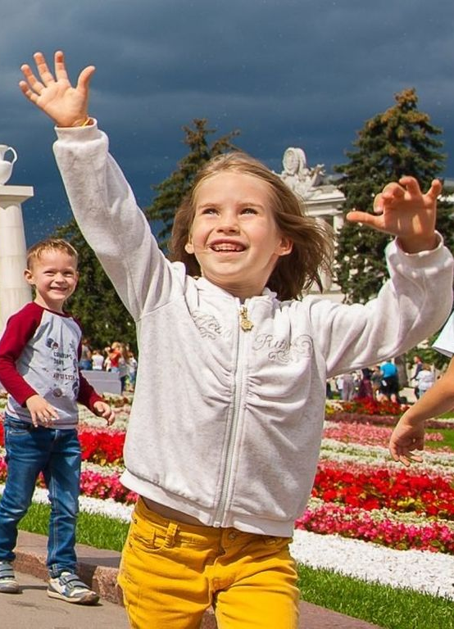
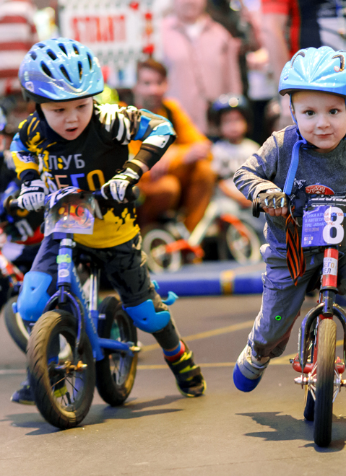
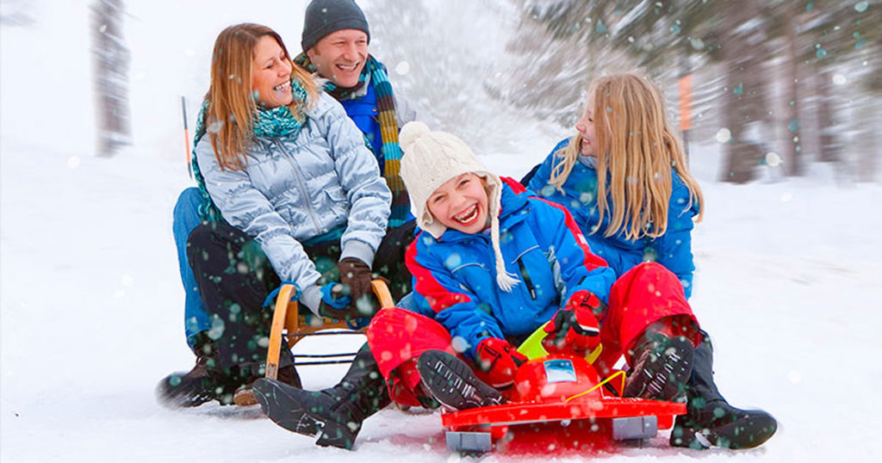
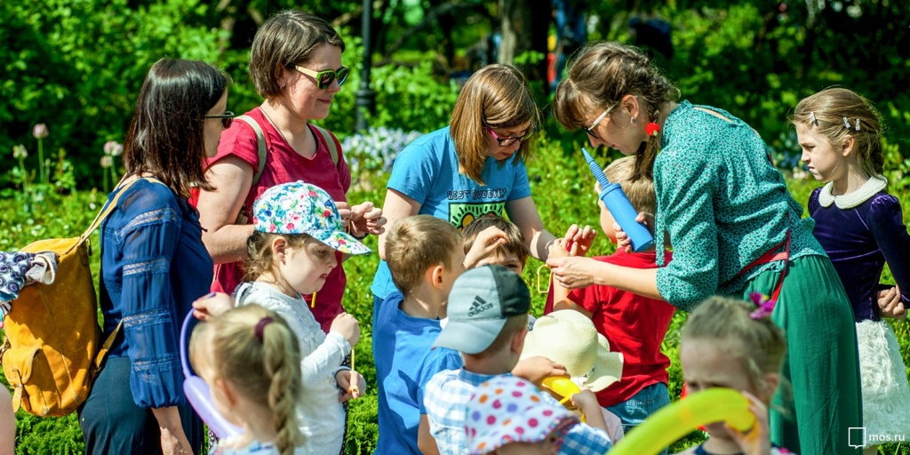
Thank you

